Slide 1
Notes on Promotion and Tenure for
New Faculty
Beverly Davenport Sypher
Vice Provost for Faculty Affairs
October 18, 2011

Slide 2
Faculty Headcounts by College/School for Fall 2010
¹One instructor in EDUC included in total count.
²Includes associate and assistant deans and department heads.
Notes:
Deans and Department Heads include associate and assistant levels.
22% of tenure/tenure-track faculty are assistant professors
28% are associate
43% are professors
7% are deans or department heads.
Nearly 70% of Purdue's academic staff and faculty are tenured or on tenure-track.
Research faculty comprise 2% of the total of academic staff and faculty; clinical faculty comprise 3.9%; continuing and limited term lecturers comprise 10.5%.
The College of Health and Human Sciences was formed administratively on July 1, 2010. The new college brings together nine academic units including all programs from the College of Consumer & Family Sciences; Health and Kinesiology, Psychological Sciences, and Speech, Language and Hearing Sciences from the College of Liberal Arts; and the Health Sciences and Nursing programs from the College of Pharmacy, Nursing and Health Sciences (renamed the College of Pharmacy).
For Tenure Track Positions, other includes: the Office of the Provost (7), Vice President for Research (2), Vice President for Student Affairs (5), Vice Provost for Engagement (1).

Slide 3

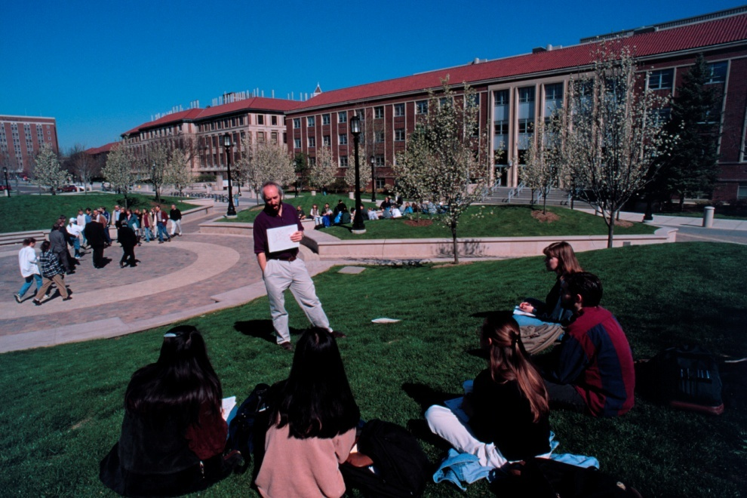

Purdue tenure-track faculty by rank
  22% are assistant professors
  28% are associate professors
43% are professors

Slide 4
Promotion and Tenure
One of the strongest predictors of pre-tenure faculty satisfaction and success is understanding the promotion and tenure process.
At Purdue, the process is described in
Executive Memorandum B-48, Section II.
http://www.purdue.edu/policies/pages/human_resources/b_48_print.html

Slide 5
Tenure at Purdue
To receive tenure, “a successful candidate should have a significant record of accomplishment as a faculty member and show promise of continued professional growth and recognition.”
Candidates are considered on “standards appropriate for the nominee’s discipline and the University’s criteria for promotion.”

Slide 6
Tenure at Purdue
“…to be considered for promotion, a faculty member should have demonstrated excellence and scholarly productivity in at least one of these areas. Ordinarily, strength should be manifest in more than one of these areas.”
Learning (teaching)
Engagement (service)
Discovery (research)

Slide 7
Time to Tenure
Assistant Professors typically have a probationary period up to 6 years to earn promotion and tenure.
The 6th year is called the “penultimate year.” It is the last year in which one is eligible for tenure.
Entering associate professors have 3 years to work toward tenure. The 3rd year is the penultimate year.

Slide 8
Tenure Clock Extensions:
When conditions and personal circumstances substantially interfere with progress toward achieving tenure.
A one-year automatic approval will be granted for birth of a child and adoption, provided a Request for Tenure-Clock Extension form is submitted within one year of the occurrence and prior to the penultimate year. This provision applies to either or both parents.
Justifiable conditions for granting exclusions include, but are not necessarily restricted to, severe illness, disability, or care-giving of a family member.

Slide 9
Levels of Review
Primary Committee: all full professors
and tenured associate professors
(Oct. and Nov.)
Area Committee: Dean, heads, some or all
full professors (Dec.)
University Committee: Provost, Deans,
and 7 faculty (February)
President and Board of Trustees approval
(April)

Slide 10
COACHE: Collaborative on Academic Careers in
Higher Education
The strongest predictor of pre-tenure faculty satisfaction and success is the clarity of the promotion and tenure process.

Slide 11
Some Suggestions
Understand process and requirements for
success very early on.
Seek advice and mentoring from technical
mentors as well as others.
You have 5 years (without any tenure clock
extensions) to showcase your excellence.
Quality and impact (not necessarily quantity)
are key.
Ask (demand) for feedback (preferably in
writing) at least once a year from head.

Slide 12
Faculty Career Progress
Assistant Professor..contract review in the 3rd year
Mentoring and feedback are critical starting
day one
Nomination to Associate Professor with
tenure no later than the beginning of the 6th
academic year
No time limit for nomination to Full
Professor . . . typically within 5-6 years from
promotion to Associate Professor
Name/Distinguished Professor
Administrative or other paths

Slide 13
Resources/Policies to Help with Climate and Success
Ask about any mentoring practices and
policies (e.g. formal mentoring in CoE)
Tenure clock extension
Purdue Teaching Academy
Child care (including infant care) is available
NSF-ADVANCE FAST and other
programs

Slide 14
Ask about any other helpful practices and policies in your college (e.g. flexible Workload Policy in CoE)
Ask about activities that may help you get involved (e.g. Women’s Faculty Committees, Diversity Action Committees)
Diversity Education: ADVANCE is collaborating with Vice-Provost for Diversity and Inclusion to develop new educational programs

